Slide 1
Amazon sales data analytics

Slide 2
Problem statement
Sales management has gained importance to meet increasing competition and the need for improved methods of distribution to reduce cost and to increase profits. Sales management today is the most important function in a commercial and business enterprise.
This project aims to perform the following task:
ETL: Extract-Transform-Load some Amazon dataset and find for me Sales-trend -> month-wise, year-wise, yearly-month-wise.
Finding key metrics and factors and show the meaningful relationships between attributes.

Slide 3

Attributes of dataset
Region
Country
Item Type
Sales Channel
Order Priority
Order Date
Order ID
Ship Date
Units Sold
Unit Price
Unit Cost
Total Revenue
Total Cost
Total Profit

Slide 4

Considering the given dataset following are the insights drawn in graphical from:
For sales trends:
Month-wise sales trend
Yearly sales trend
Yearly-month-wise sales trends
Monthly units sold through online/offline sales channel
Yearly units sold through online/offline sales channel

Slide 5
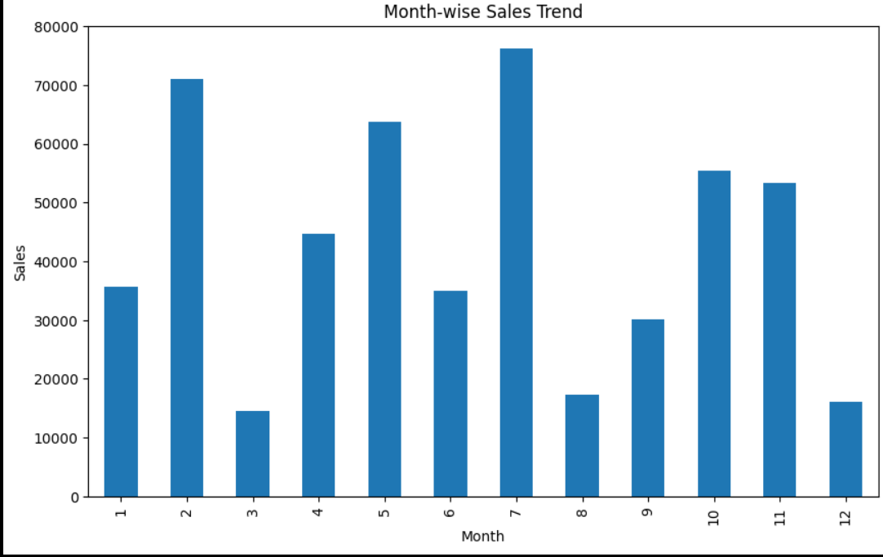

Slide 6
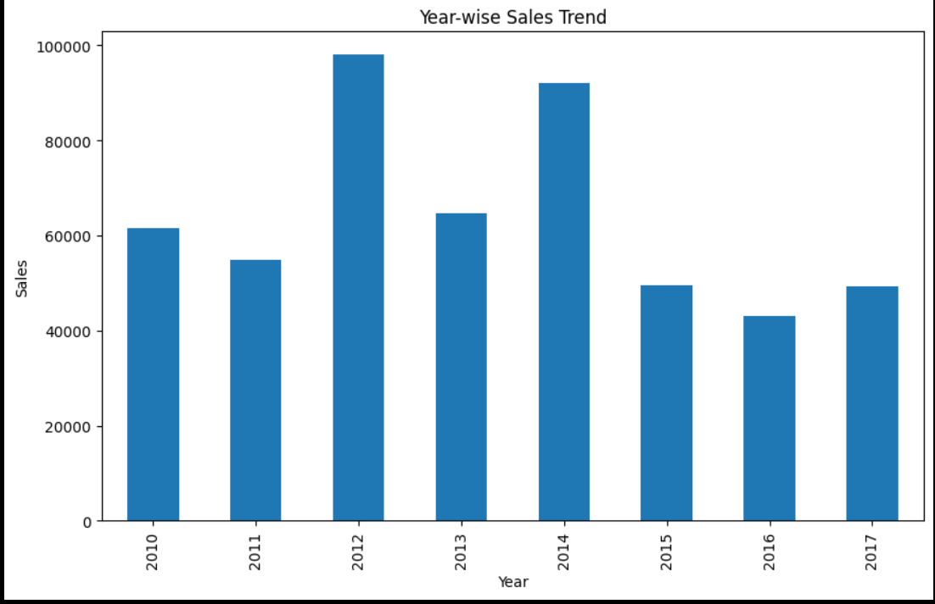

Slide 7
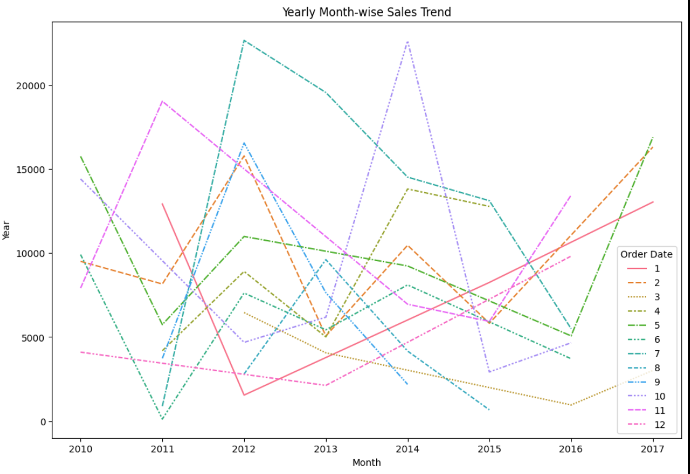

Slide 8
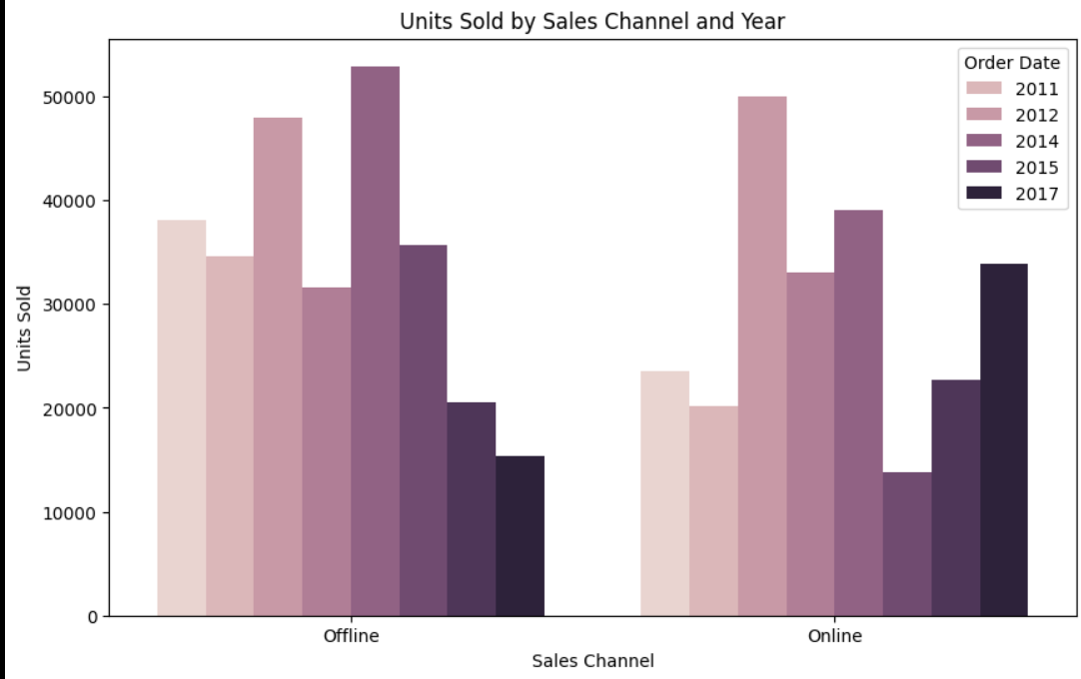

Slide 9
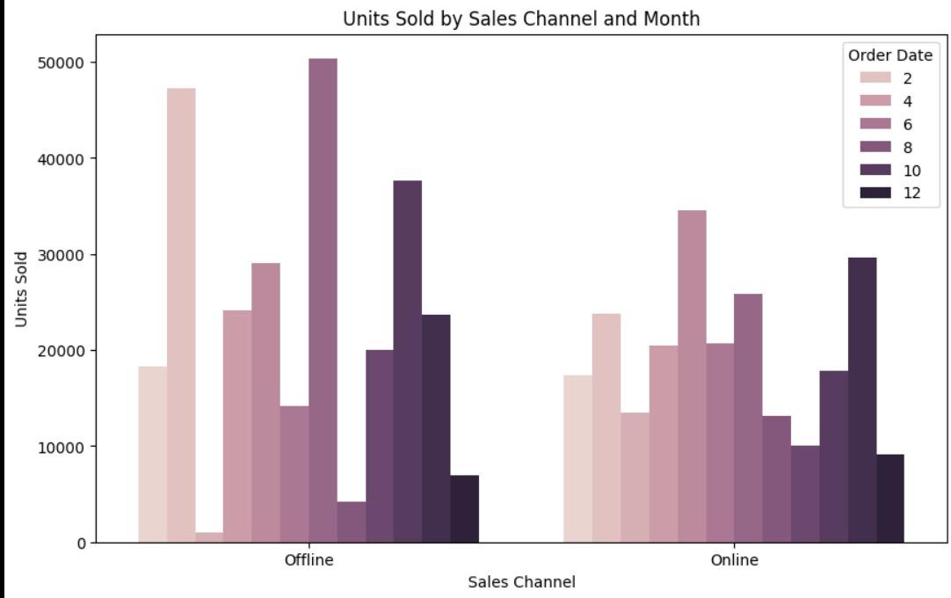

Slide 10
For Revenue trends:
Month-wise revenue trend
Yearly revenue trend
Yearly-month-wise revenue trends
Total revenue from each country
Total revenue from each region
Total revenue from each region of a country.
Revenue through online/offline sales channel for every month.
Revenue through online/offline sales channel for every year.

Slide 11
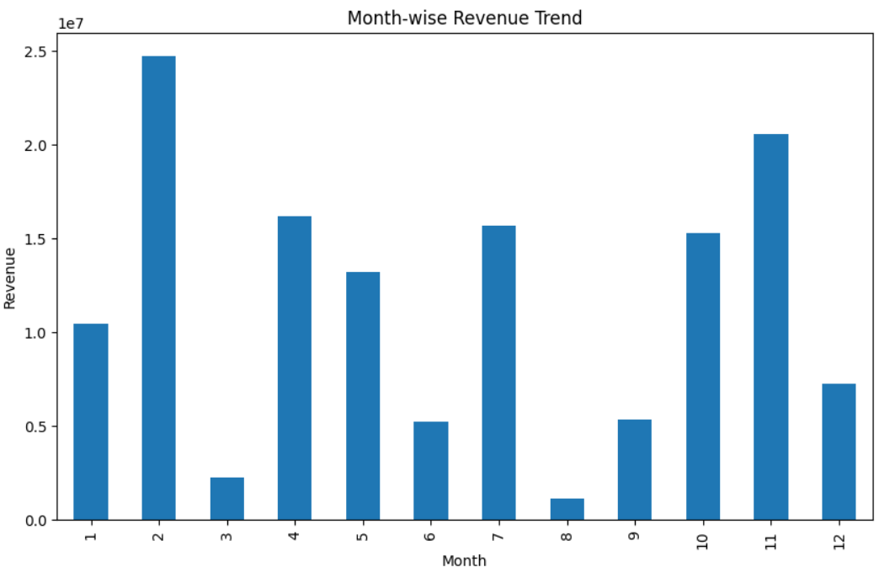

Slide 12
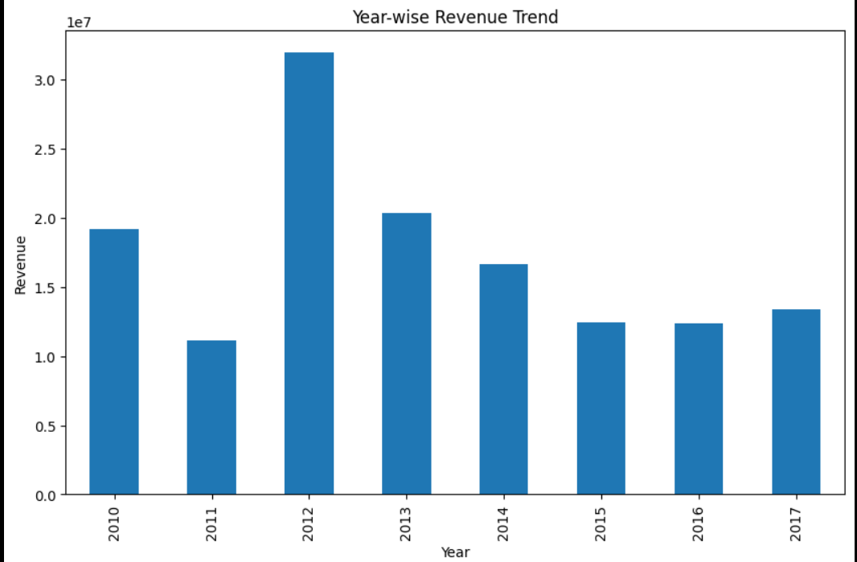

Slide 13
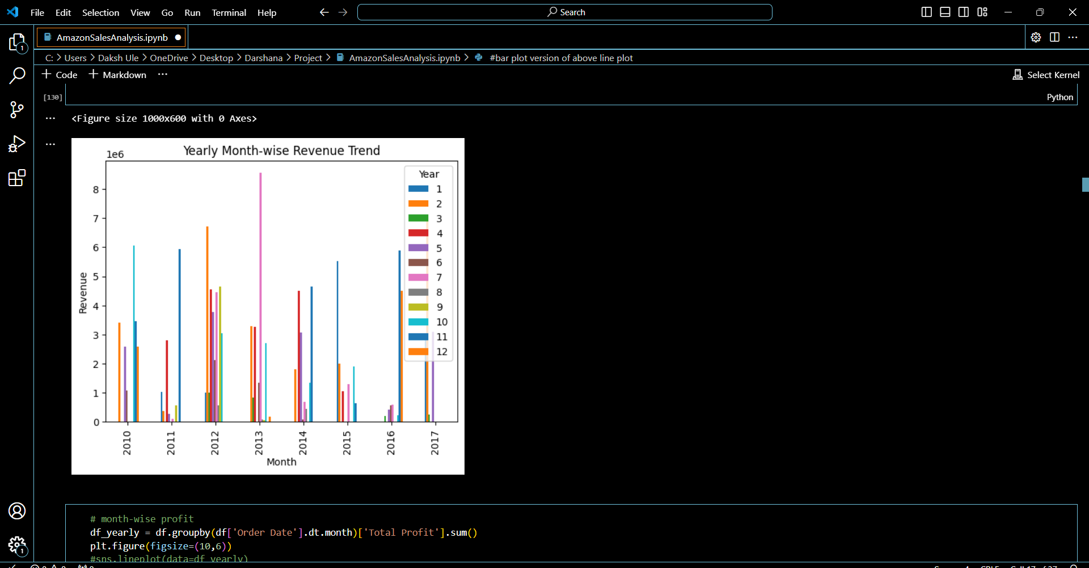

Slide 14
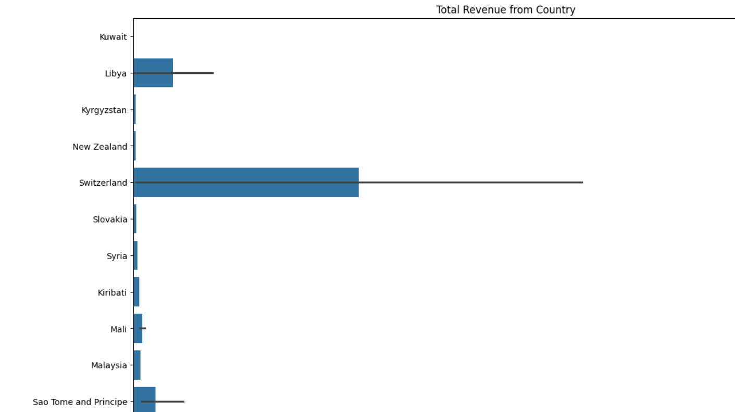

Slide 15
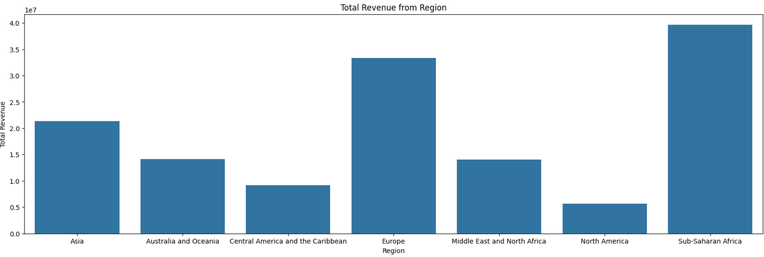

Slide 16
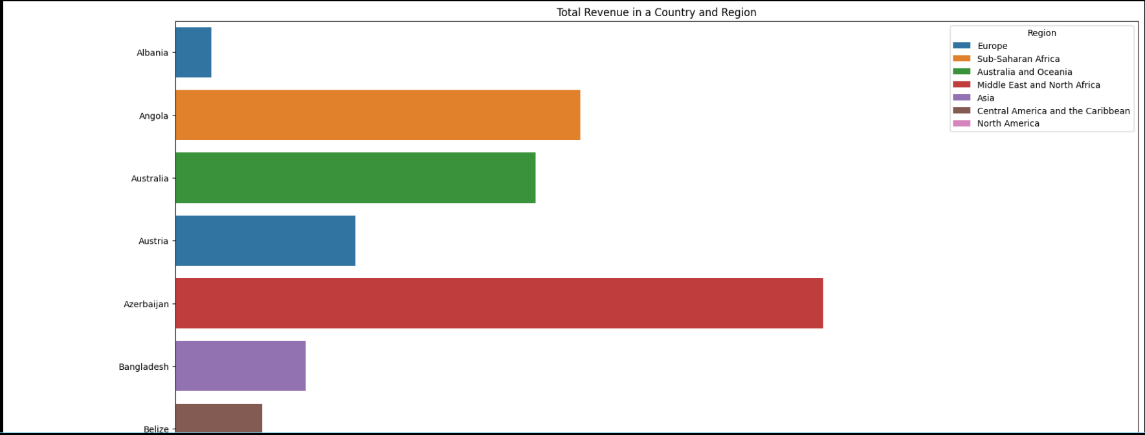

Slide 17
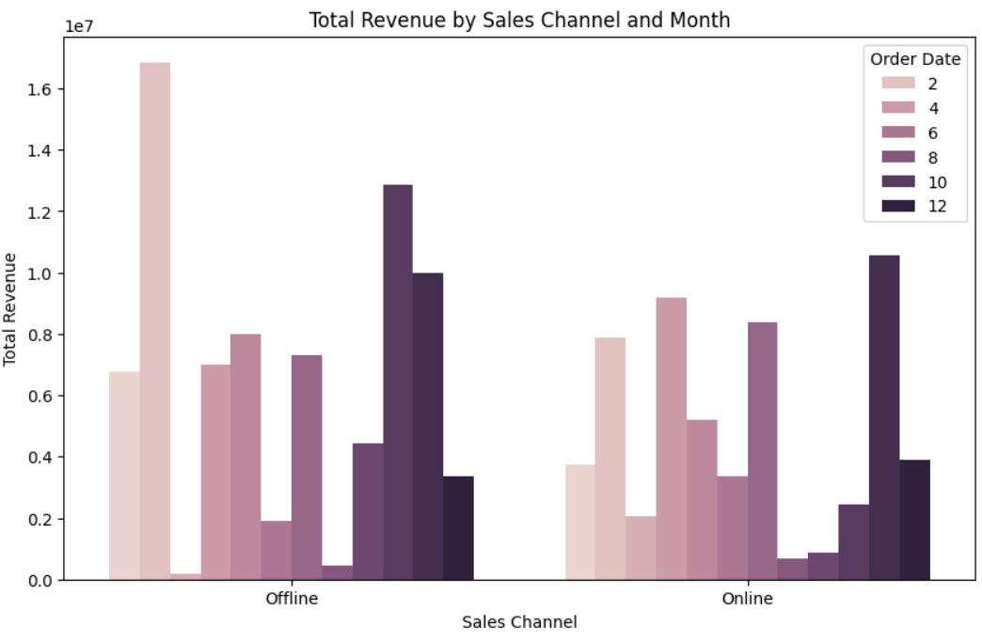

Slide 18
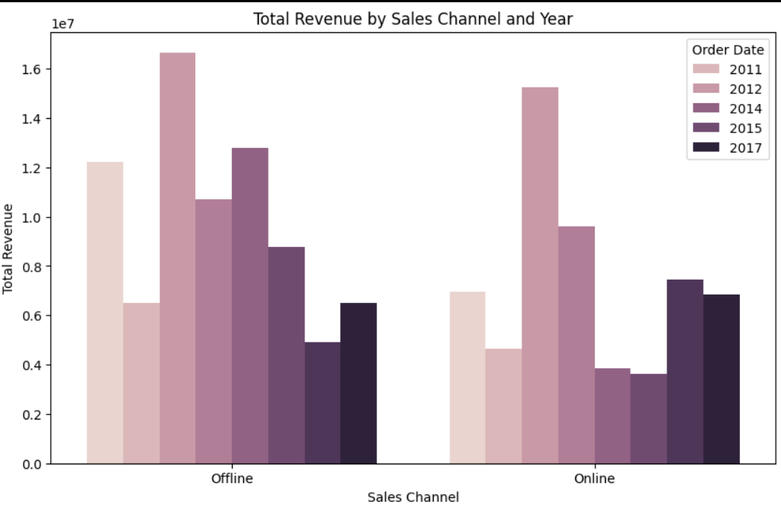

Slide 19
For Profit trends:
Month-wise profit trend
Yearly profit trend
Yearly-month-wise profit trends
Total profit from each country
Total profit from each region
Total profit from each region of a country.
Profit through online/offline sales channel for every month.
Profit through online/offline sales channel for every year.

Slide 20
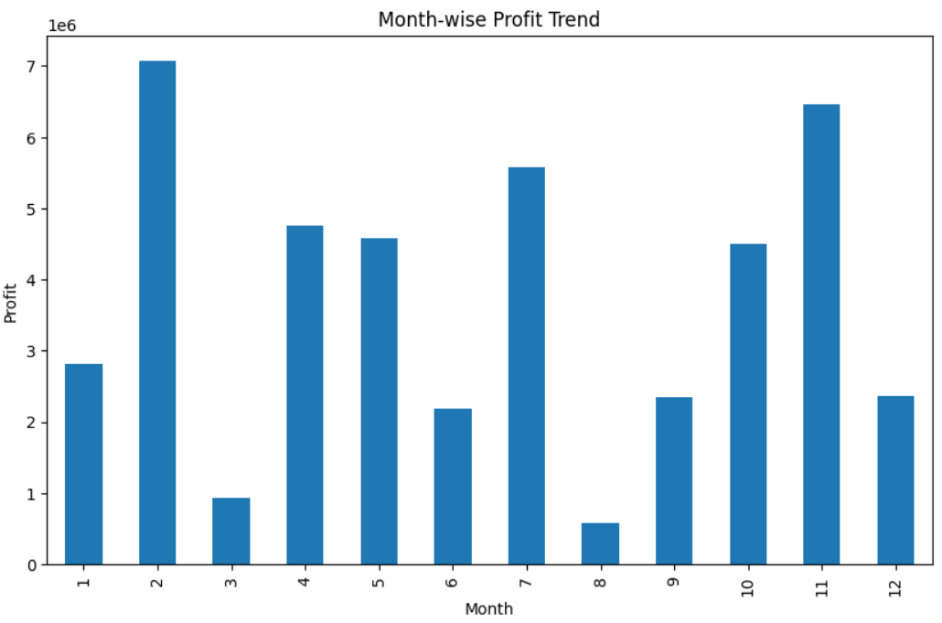

Slide 21
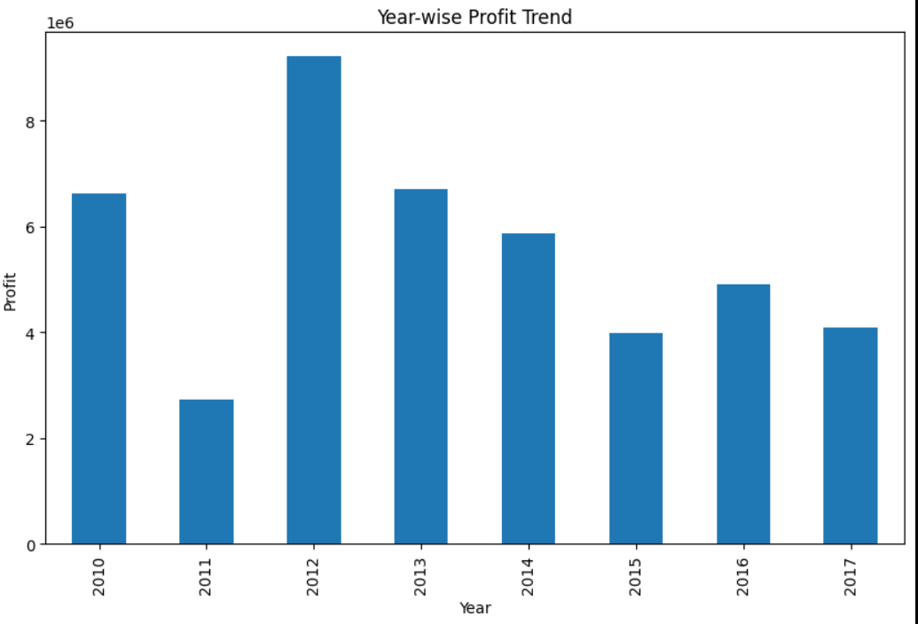

Slide 22
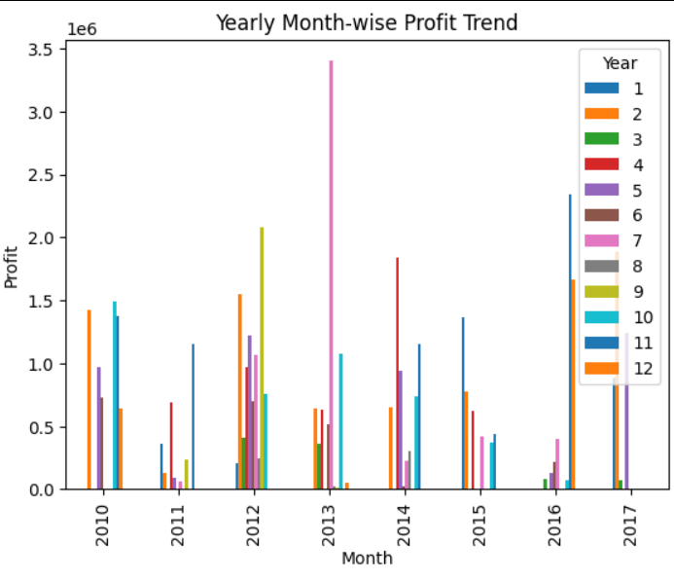

Slide 23
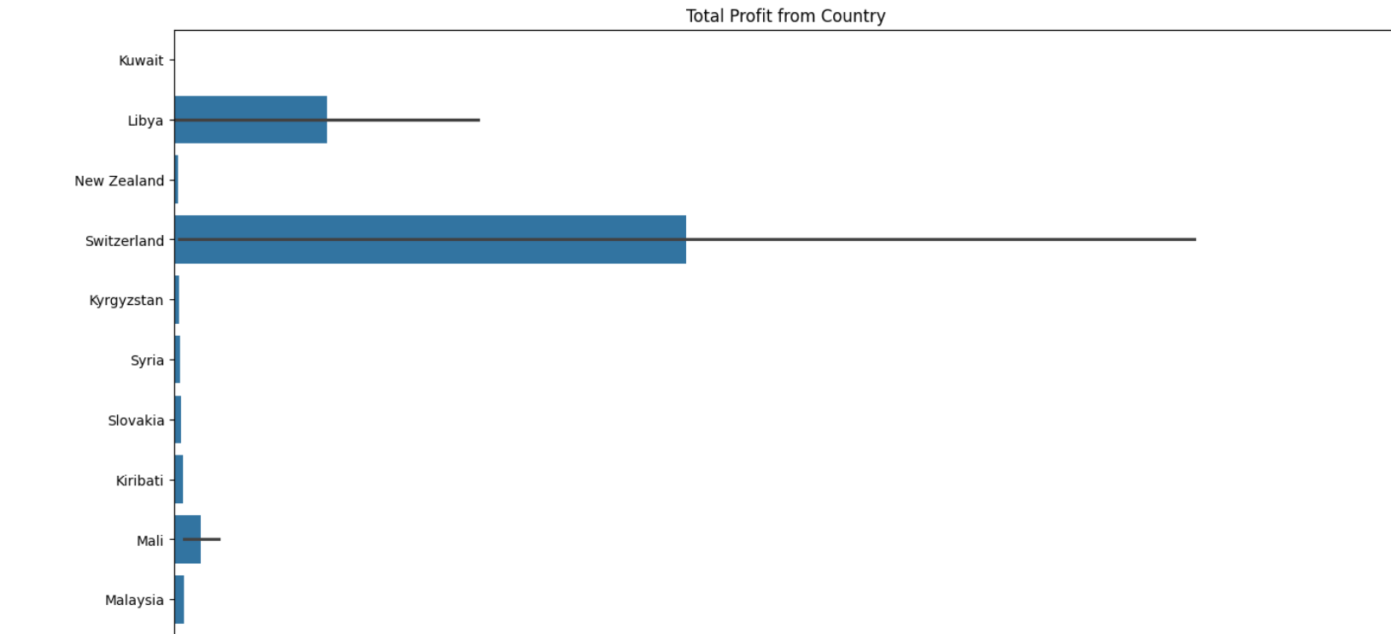

Slide 24
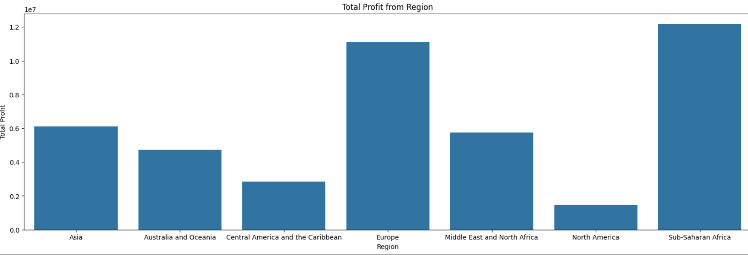

Slide 25
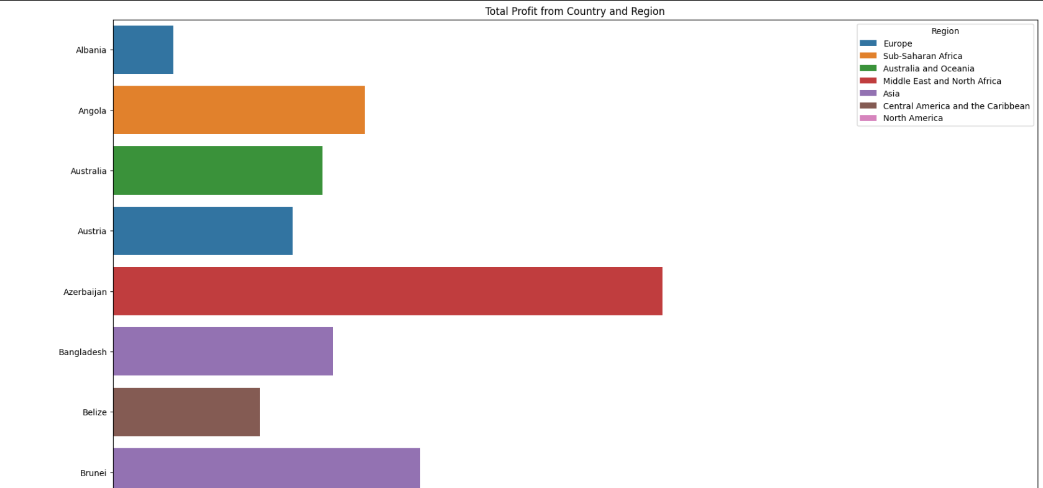

Slide 26
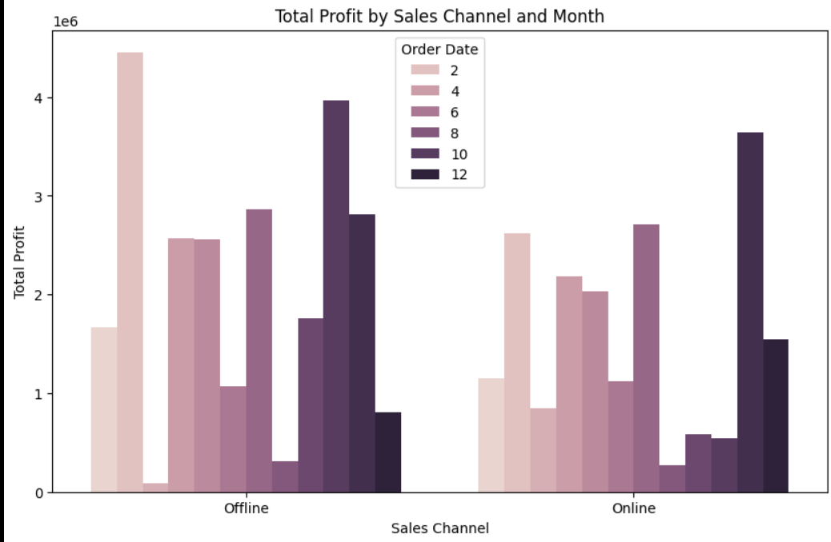

Slide 27
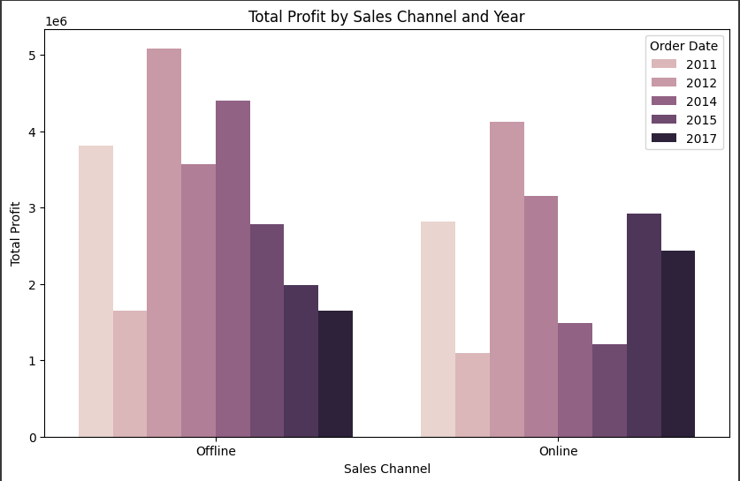

Slide 28
Thank you

